Slide 1
Applications of Suffix Trees
Charles Yan
2008

Slide 2
1. Exact String Matching
|P|=n, |T|=m
P and T are both known at the same time
Boyer-Moore, or Suffix trees. O(n+m)
T is known and kept fixed. P varies.
Suffix trees, O(m) in preprocess, O(n+k) in searching
P is known and kept fixed. T varies.
Boyer-Moore, O(n) in preprocess, O(m) in searching

Slide 3
2. Exact Set Matching
|T|=m, P={p₁, P₂, …, p_{i}}, ∑|p_{i}|=n
Aho-Corasick
O(m+n+k)
Suffix trees.
O(m) in building suffix tree
O(n_{i}+k_{i}) in searching for p_{i}
O(m+∑n_{i}+ ∑k_{i}) for all P, i.e. O(m+n+k)

Slide 4
3. Substring problem for a set of texts
Motivation 1:
T is a DNA database containing millions of DNA sequences that have been previously sequenced.
Given a new DNA sequence, to determine whether it has been previously sequenced.
(1) Concatenate all T together, then use Boyer-Moore
O(m+n+k) for searching each P, m is huge!
(2) Build a suffix tree for each T_{i}
O(m) for total preprocessing, but O( i* n+k) for searching each P, i is in the order of 10⁶!

Slide 5
Substring problem for a set of texts
Motivation 2:
To identify the remains of military personnel
For each soldier, a set of DNA sequences (T= {T₁, T₂, …, T_{i}}) is kept when he/she joins the army. (The whole genome sequence is very difficult to obtain for technical reasons.)
A DNA sequence (P) is extracted from the remains of personnel that have been killed.
To determine whether the remains belong to soldier A, we just need to see whether P matches any sequence in the T of A.

Slide 6
3. Substring problem for a set of texts
Given T={T₁, T₂, …, T_{i}}, ∑|T_{i}|=m, |P|=n, set T is fixed, P varies. O(m) preprocessing time is allowed. For each coming P, to find all occurrences of P in all T with O(n+k) time
For each given P, this a the reverse of exact set matching problem.
(1) Concatenate all T together, then use Boyer-Moore
O(m+n+k) for searching each P
(2) Build a suffix tree for each T_{i},
O(m) for total preprocessing, but O( i* n+k) for searching each P
(3) Build a suffix tree (generalized suffix tree) for the set T,
the searching will take O(n+k) time
but how to build the a generalized suffix tree in O(m)?

Slide 7
Generalized Suffix Trees
How to build the generlized suffix tree for a set T = {T₁, T₂, …, T_{i}) in O(m)?
Append a marker to the end of each string and concatenated them together to build a new string S.
Build a suffix tree for S.
But, suffixes span multiple T_{i},
a
b
$
d
e
f

Slide 8
Generalized Suffix Trees
Minor subtleties
Each edge is associated with three indices (i,p,q), where indicates that the substring come from T_{i}. p and q are the begin and end positions.
Suffixes from two texts may be identical. Thus, each leaf is associated with labels indicating all of the strings and starting positions of the associated suffix.

Slide 9
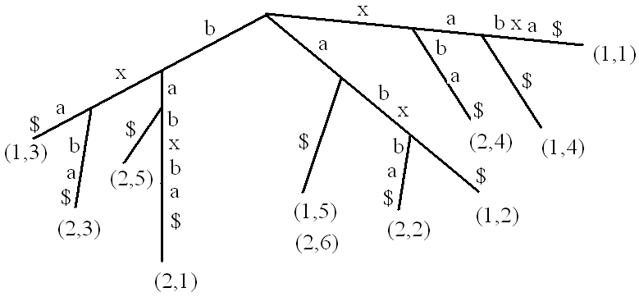
Generalized Suffix Trees
T₁: xabxa
T₂: babxba

Slide 10
Generalized Suffix Trees
How to build the suffix tree for a set T = {T₁, T₂, …, T_{i}) in O(m)?
(1) Build a suffix tree for T₁$
(2) Start from the root of the tree search for T₂. Assume that i characters in T₂ are matched,
The suffix tree has implicitly encoded every suffix of T₂[1,..i]
The suffix tree contains I_{i} for T₂
We can skip phase 1,..,i for T₂
(3) Continue the Ukkonen’s algorithm on T₂ in phase i+1
Walk up from the end of T₂[1,..i], …
(4) Until all T_{i} are included in the suffix tree.

Slide 11
4. Longest Common Substring (LCS) of Two Strings
Given strings S1 and S2, find the LCS of them.
Different from longest common subsequence problem.
S₁: xabxa
S₂: babxba
LCS is abx

Slide 12
4. Longest Common Substring (LCS) of Two Strings
Build a generalized suffix tree for S1 and S2
If a leave is from S₁, then mark all its ancestors with 1.
If a leave is from S₂, then mark all its ancestors with 2.
The path-label of any node that is marked with both 1 and 2 is a common substring of S₁ and S₂.
Find the node that is labeled with 1 and 2, and has the greatest string-depth (number of characters on the path to it).

Slide 13
Generalized Suffix Trees
T₁: xabxa
T₂: babxba
1,2
1,2
1
1,2
1
1,2
1,2
2
1,2
1
1
2
2
2
1,2
1
2
2

Slide 14
4. Longest Common Substring (LCS) of Two Strings
O(m) for building generalized suffix tree
O(m) for calculating the string-depth of each node (e.g. Breadth first)
O(m) for marking node with 1 or 2 (e.g. Depth first)
O(m) finding the longest.

Slide 15
5. DNA Contamination Problem
DNA contamination: During laboratory processes, unwanted DNA inserted into the DNA of interest.
Contamination sources: Human, bacteria,…
DNA from Dinosaur bone: More similar to human DNA than to bird and crockodilian DNA

Slide 16
5. DNA Contamination Problem
S: DNA of interest
P: DNA of possible contamination source
If S and P share a common substring longer than l , then S has been contaminated by P.
To find all common substrings of S and P that are longer than l .
In general, P is set of DNA that are potential contamination sources.

Slide 17
Generalized Suffix Trees
T₁: xabxa
T₂: babxba
1,2
1,2
1
1,2
1
1,2
1,2
2
1,2
1
1
2
2
2
1,2
1
2
2

Slide 18
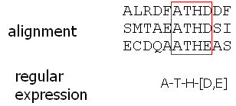
6. Common Substrings Of More Than Two Strings
Motivation

Slide 19
6.Common Substrings Of More Than Two Strings
Problem statement: Given K strings whose lengths sum to n, let l(i) be the length of the longest substring common to at least i strings, to compute a table of K-1 entries, where entry i give l(i) and one of the common substrings of that length (and that is shared by at least i strings)
{sandollar, sandlot, handler, grand, pantry}
i | l(i) | substring
2 | 4 | sand
3 | 3 | and
4 | 3 | and
5 | 2 | an

Slide 20
6. Common Substrings Of More Than Two Strings
It can be solve in O(n) time.
But, an easy algorithm that uses O(kn) time first.
Build a generalized suffix tree for the k strings giving each string a unique end marker.
Each leaf belong to only one string
For a node (v), let c(v) be the number of distinct string identifiers that appear at the subtree below it.
V is a vector with V(i) denoting the length of the longest substring that occurs exactly in i strings (and a pointer to the node).
From V(i) compute l (i),
for i=k; i>1; i—
if (V(i)<V(i+1)), then l(i)= V(i+1)
else l(i)= V(i)

Slide 21
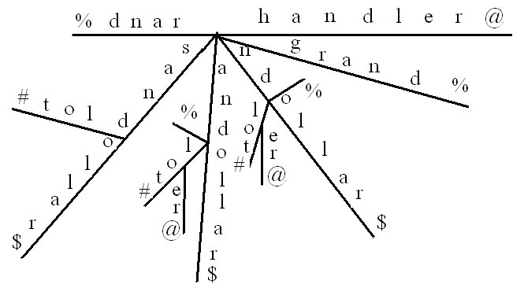
6. Common Substrings Of More Than Two Strings
5
4
2
2
4
2
V
 | 4 | 2 | 3 | 2
l
 | 4 | 3 | 3 | 2

Slide 22
6. Common Substrings Of More Than Two Strings
Calculating c(v) is the bottle neck.
Can’t just count the number of leaves below it.
For each node keep a C vector of k bits, with one bit correspond to one string.
i^{th} is set to 1 if a leave that belongs to i^{th} string appear below the node
The V vector of a parent is obtained by ORing the vectors of its children.
n nodes.
O(Kn) in calculating c(v).

Slide 23
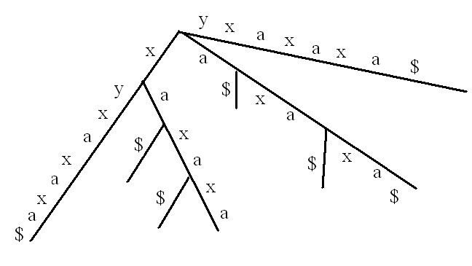
Suffix Trees to DAGs
Space is a big problem for suffix trees.
S: xyxaxaxa$
The subtree under p is isomorphic to that under q except for leaf labels
q
2
p
8
7
6
4
5
3
1

Slide 24
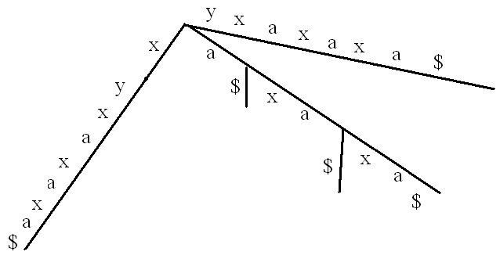
Suffix trees to DAGs
Directed acyclic graph (DAG)
a
2
8
6
4
1

Slide 25
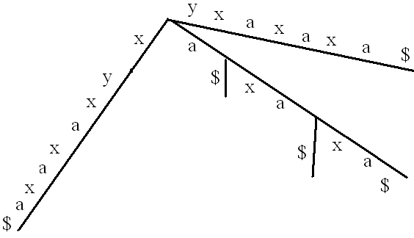
Suffix Trees to DAGs
S: xyxaxaxa$
P: xax
2
a
2
-1
8
8
7
6
6
4
4
5
1
3

Slide 26
Suffix Trees to DAGs
q
2
a
2
p
-1
8
8
7
6
6
4
4
5
1
3
If the subtrees under p and q are isomorphic (except leaf lables) and stringdepth(p)> stringdepth(q), then
Merge p into q, by adding a direct edge from parent(p) to q
Associated the directed edge with d=stringdepth(q)- stringdepth(p)
When search for P in the S (text), let i be the leaf below the path labeled with P, if the directed edge is traversed then P occurs at i+d, otherwise P occurs at i.

Slide 27
Suffix Trees to DAGs
How to determine whether a subtree is isomorphic to another one?
Theorem 7.7.1
In suffix tree T the subtree below a node p is isomorphic to the subtree below a node q if and only if
there is a directed path of suffix links from one node to the other node and
the numbers of leaves in the two subtrees are equal.
A if and only if B
B→A
A→B

Slide 28
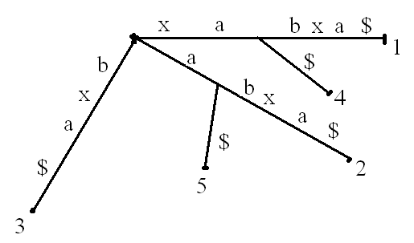
Ukkonent Algorithm
Suffix links
Let xα denote an arbitrary string, where x denotes a single character and α denotes a (possible empty) substring. For an internal node v with path-label xα, if there is another node s(v) with path-label α, then a pointer from v to s(v) is called a suffix link, denoted as (v,s(v)).
The root has no suffix link from it.
If α is empty, then the suffix link points to
the root.
v
s(v)

Slide 29
Suffix Trees to DAGs
B→A
Only one suffix link
For every path from p to a leaf in its subtree, there is an identical path from q to a leaf in its subtree.
x
α
α
q
p
β
β
i+1
i
x
α
β
i

Slide 30
Suffix Trees to DAGs
B→A
A path of suffix links
For every path from p to a leaf in its subtree, there is an identical path from q to a leaf in its subtree.
x
q
α
α
u
t₃
p
t₁
β
β
t₂

Slide 31
Suffix Trees to DAGs
A→B
Either α is a proper suffix of γ
or γ is a proper suffix of α
There is a directed path of suffix links from one node to the other.
α
γ
q
p
…
β
β
i+1
i
α
β

Slide 32
Suffix Trees to DAGs
λ
q
A→B
Either α is a proper suffix of γ
or γ is a proper suffix of α
There is a directed path of suffix links from one node to the other.
β
α
γ
u
t₃
p
t₁
β
t₂
α
β
λ
β

Slide 33
Suffix Trees to DAGs
Let Q be the set of all pairs (p,q) such that there is a suffix link from p to q.
While there is a pair (p,q) in Q
Merge p into q;
Remove (p,q);
The merge of the pairs can be done in arbitrary order.
In practice, we can start merge in a top-down approach (depth-first).

Slide 34
Suffix Arrays—more space reduction
Given a m-character string T, a suffix array for, called Pos, is an array of integers in the range 1 to m, specifying the lexicographic order of the m suffixes of string T.
Pos[i] lexically less than Pos[i+1]
mississippi
pos 11,8,5,2,1,10,9,7,4,6,3

Slide 35
Suffix tree to suffix array
In O(m) time
Lexical depth-first search

Slide 36
Pattern searching using suffix arrays
Observation: If p occurs in T then all the locations of those occurrences will be grouped consecutively in Pos.
P=issi
T=mississipi

Slide 37
Pattern searching using suffix arrays
Basic idea: Binary search
O(nlogm) (worst)
O(n+logm) (expected)

Slide 38
A simple accelerant
L and R are left and right boundaries of the “current search interval”.
Query will be made at M=(L+R)/2 of Pos.
l: the length of the longest prefix of Pos(L) that match a prefix of P
r: the length of the longest prefix of Pos(R) that match a prefix of P
lmr=min{l,r}
Compare P and Pos(M) starting from position lmr+1 of the two string.
O(nlogm)

Slide 39
A super accelerant
Lcp (i,j): length of the longest prefix of Pos(i) and Pos(j)
Use Lcp(L,M), Lcp(M,R)
Suppose l>r,
If Lcp(L,M) >l, L←M, and l, r unchanged
If Lcp(L,M) <l, R←M, r=Lcp(L,M)
If Lcp(L,M)=l, comparison of P and Pos(M) starting at l+1.
O(n+logm)

Slide 40
To obtain Lcp (i,j)
Lcp (i,i+1) for i=1 to m-1
Lexical depth first search
For any i<j, Lcp(i,j) is the smallest value of Lcp(k,k+1), where, k=i to j-1
Lexical depth first search in a complete binary tree

